Slide 1
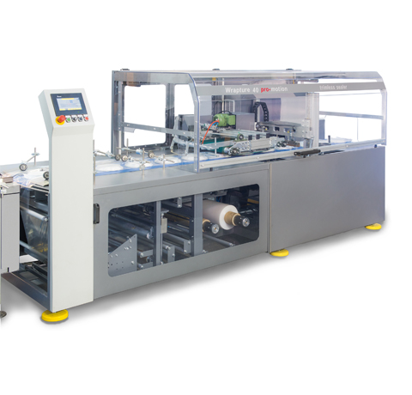
Shrink Wrapper Failure Prediction
By
George Sylva
This Photo by Unknown Author is licensed under CC BY-SA-NC

Slide 2
Outline
Executive Summary
Introduction
Methodology
Results/Findings
Conclusion
Presentation Title

Slide 3
Introduction
The goal of this analysis is to predict failures in a shrink-wrapping machine using various machine-learning models. The data is preprocessed to handle class imbalance and outliers, and multiple resampling techniques and models are tested to determine the best approach for accurate predictions.
This Photo by Unknown Author is licensed under CC BY-SA-NC

Slide 4


Data Source from: https://www.kaggle.com/datasets/inIT-OWL/vega-shrinkwrapper-runtofailure-data 1. Data loading 2. Exploratory Data Analysis 3. Feature Engineering/preprocessing 4. Model Building and monitoring
Methodology

Slide 5
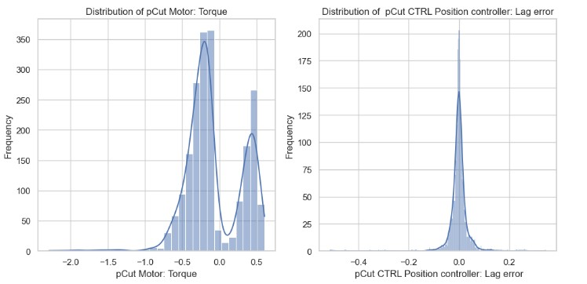
Data Visualization (Distribution Plots)

Slide 6
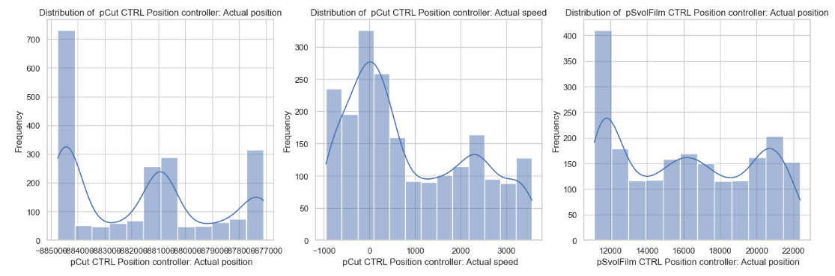
Data Visualization (Distribution Plots)

Slide 7
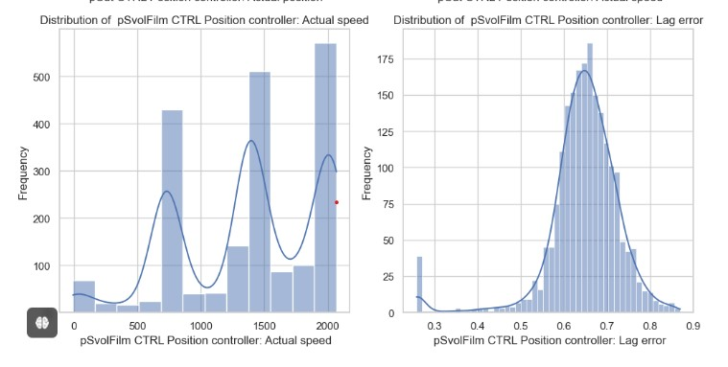
Data Visualization (Distribution Plots)

Slide 8
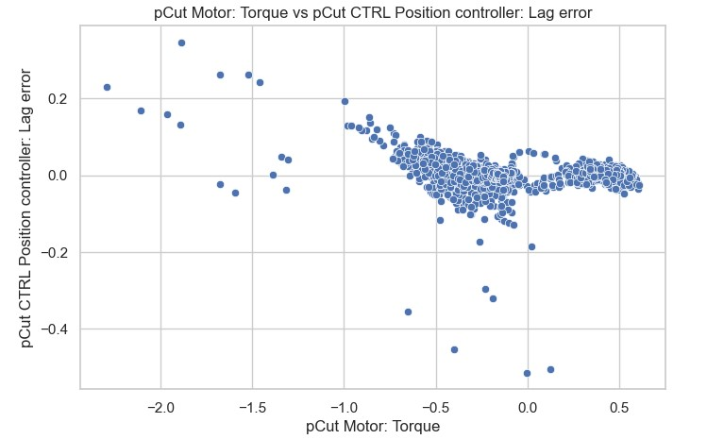
Data Visualization

Slide 9
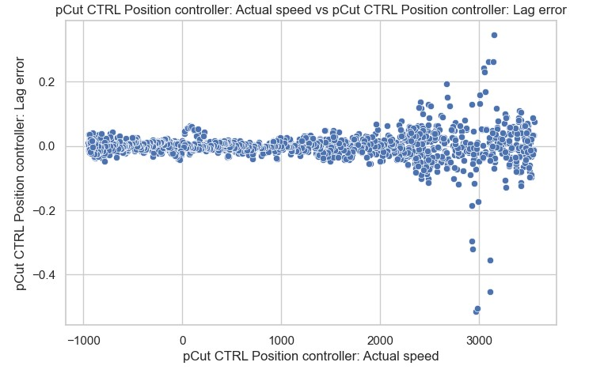
Data Visualization

Slide 10
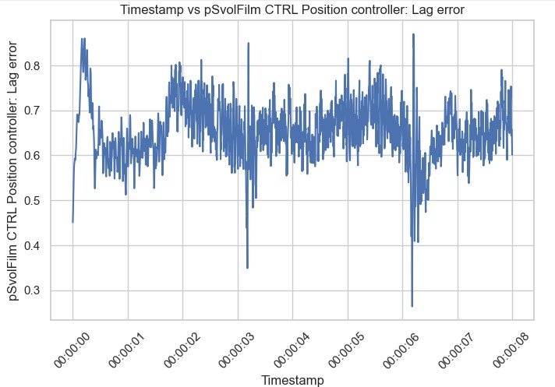
Data Visualization

Slide 11
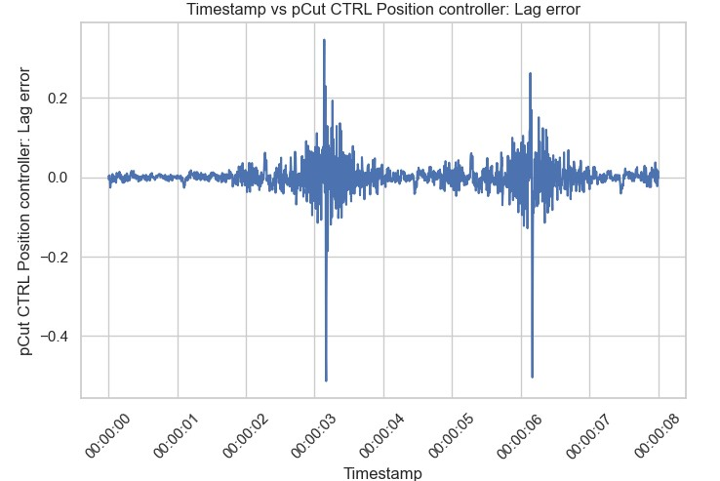
Data Visualization

Slide 12
Feature Engineering/Preprocessing 1. Failure-Likelihood feature creation 2. Standard Scaler used 3. Multiple algorithms tried for outcome feature categorical balancing 4. Multiple models also tried and evaluated

Slide 13

Results/Findings
No Balancing done
Balancing done
Most models did well possibly due to the threshold set and used as a yardstick for outcome feature creation
Most models did well possibly due to the threshold set and were used as a yardstick for outcome feature creation
Cross-validation was also used to check most of the models performance

Slide 14
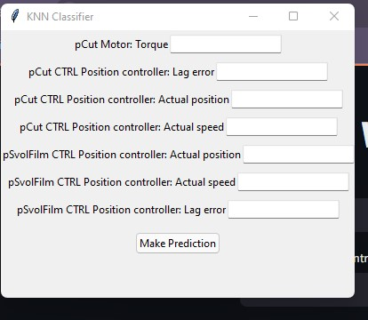
Local UI

Slide 15
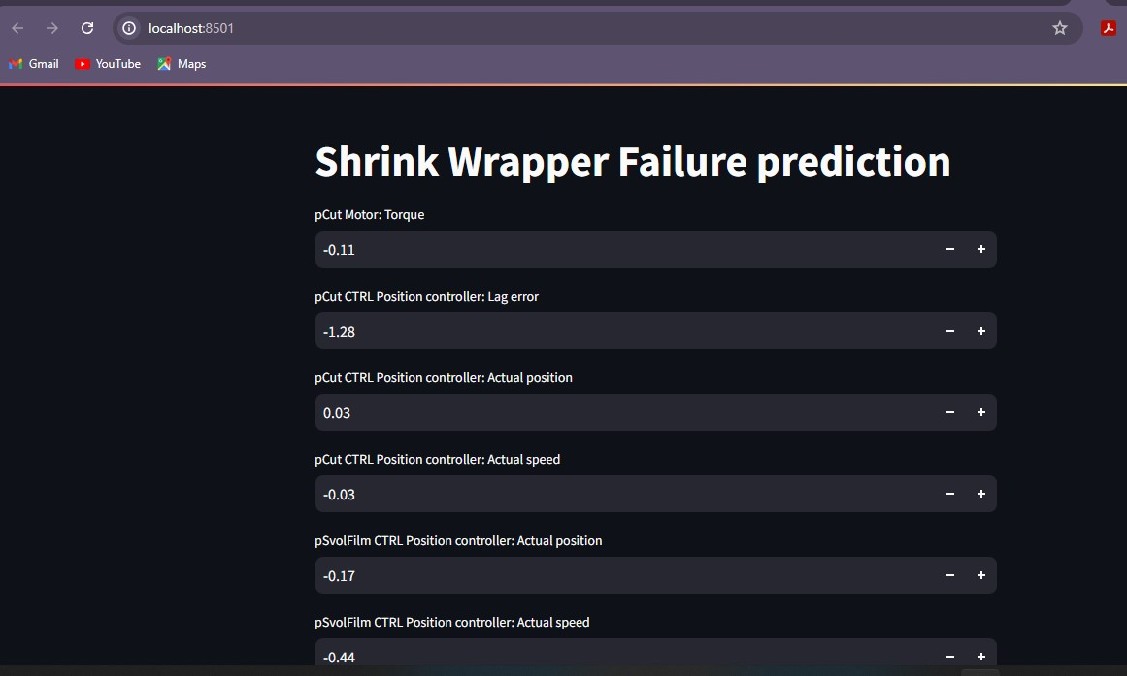
Using Streamlit

Slide 16
Conclusion
The Industrial shrink wrapper failure is monitored using machine learning to check the sensors monitoring the actual speed and lag errors of various motors within the machine and a wide range in the lag error compared to where the various motors are to be positioned.

Slide 17



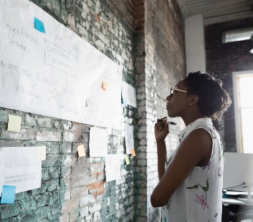
Thank you
George Sylva
georgesylva@gmail.com
https://github.com/georgesylva1
https://linkedin.com/in/george-sylva-ba901811a

